Slide 1
GALA CRICKET CLUB
SPONSORSHIP AND HOSPITALITY
BROCHURE 2023

Slide 2
ALL SPONSORSHIPS
WHAT’S INCLUDED?
COMPLIMENTARY CLUB MEMBERSHIP
REGULAR COVERAGE ON WEBSITE & SOCIAL MEDIA WITH OVER 4,000 FOLLOWERS
INVITE TO SUPPORTERS & SPONSORS DAY WITH COMPLIMENTARY DRINKS AND BUFFET
SUPPORT ONE OF OLDEST SPORTS CLUBS IN GALA ENTERING ITS 170TH YEAR
Page 1

Slide 3
OPPORTUNITIES
FOR OUR FULL RANGE OF SPONSORSHIP OPPORTUNITIES FOR 2023 PLEASE CONTINUE THROUGH THE BROCHURE. WE ARE DELIGHTED TO OFFER SPONSORSHIP OPPORTUNITIES IN A RANGE OF AREAS AND PRICE BRACKETS TO SUIT ANY POTENTIAL SPONSOR.
WE APPRECIATE THE IMPACT THAT COVID AND COST CRISIS HAS HAD ON THE LOCAL ECONOMY. PLEASE GET IN TOUCH SHOULD YOU WISH TO SUPPORT US IN ANY OTHER WAY, OR WE CAN SUPPORT YOU IN ANY WAY. GET IN TOUCH IF YOU HAVE A REQUEST.
WEBSITE — WWW.GALACRICKETCLUB.CO.UK
EMAIL – GALACRICKETCLUB@GMAIL.COM
Page 2

Slide 4
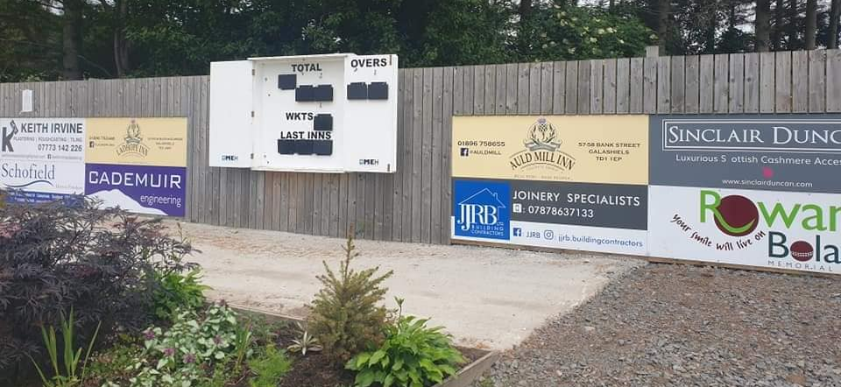
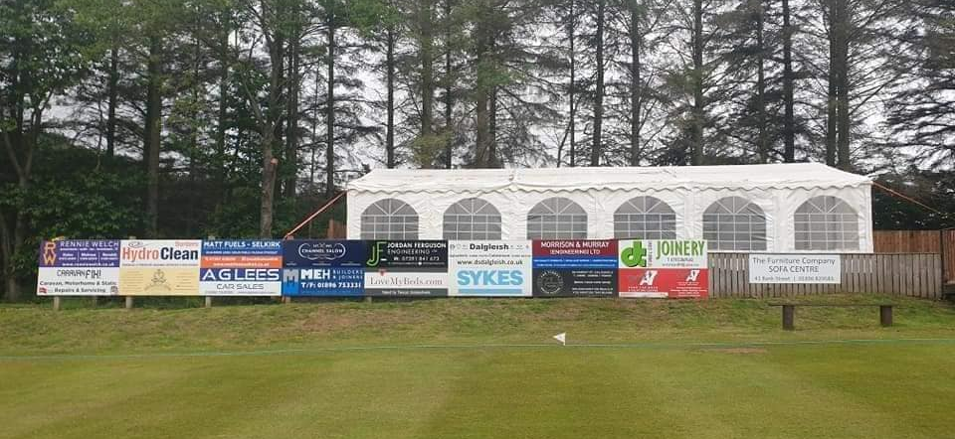
MEIGLE PARK SPONSOR BOARDS
The club is offering sponsorship boards which are in place permanently at Meigle Park.
The boards accompany our brand new event and beer garden area with our marquee, all newly built in 2021. The area sees many events held throughout the year such as gin nights, ladies day and tea in the tent.
The club will source the board and put them in place — all you need to do is provide your company’s logo and any promotional wording.
Limited availability.
Cost: £200 per year or £500 for three years.
Page 3

Slide 5
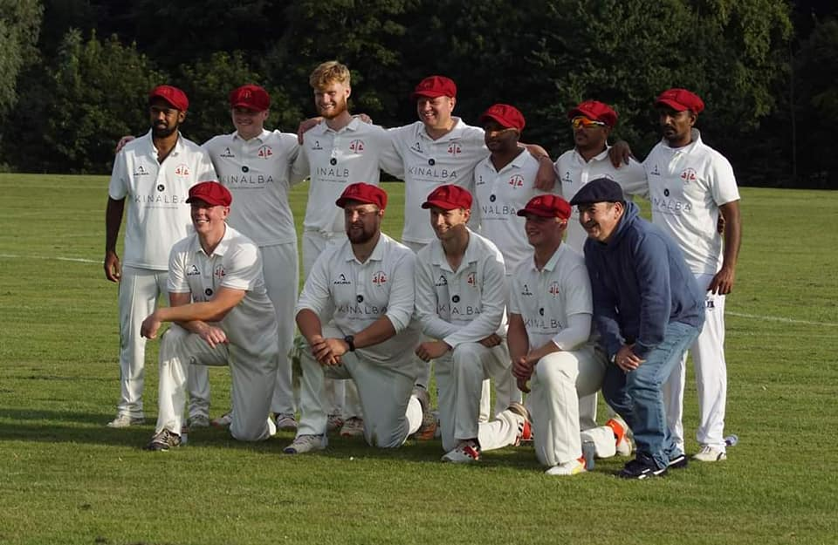
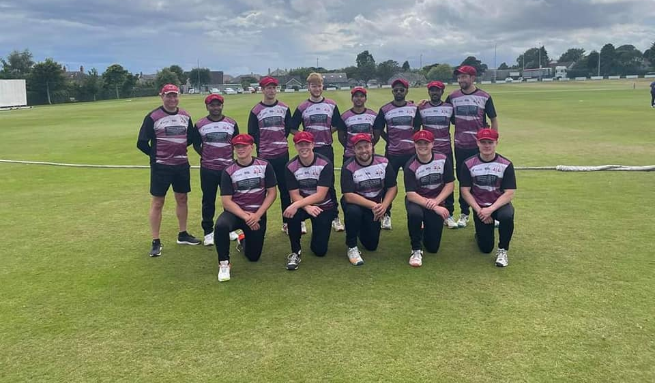
TEAM SPONSORSHIP
Club Sponsors:
Company name/logo on all 1st and 2nd XI playing shirts. Acknowledgement as sponsors on all match programmes, prominent position on website, social media and local press photo opportunities.
Sponsorship opportunities available alongside current sponsors Kinalba & Keith Irvine Plastering
Junior Cricket Sponsors:
Company name/logo on all age grade shirts. Acknowledgement as sponsors on all match programmes, social media and local press photo opportunities.
Sponsorship opportunities available alongside current sponsors Rowan Boland Memorial Trust, Cademuir Engineering, Matts Fuels & Caravan Fix
Page 4

Slide 6
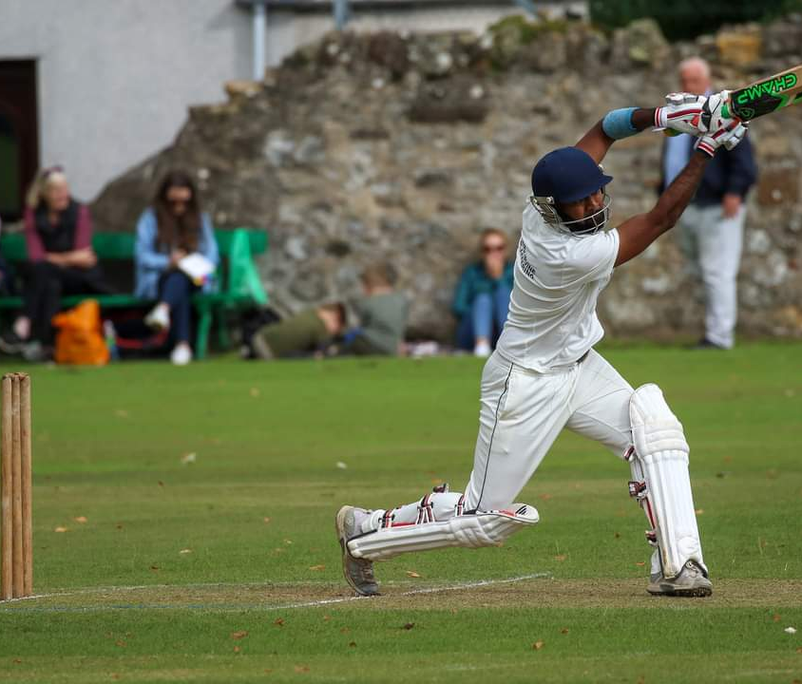
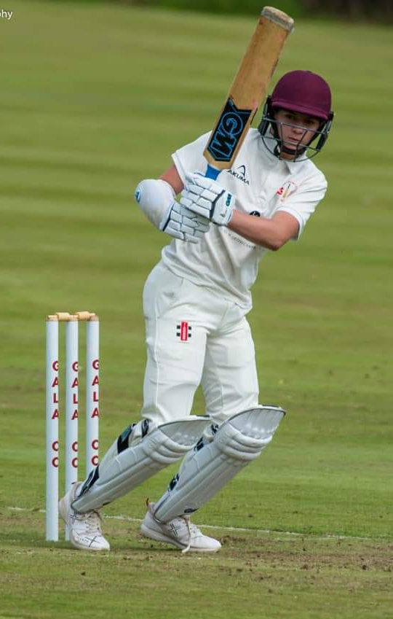
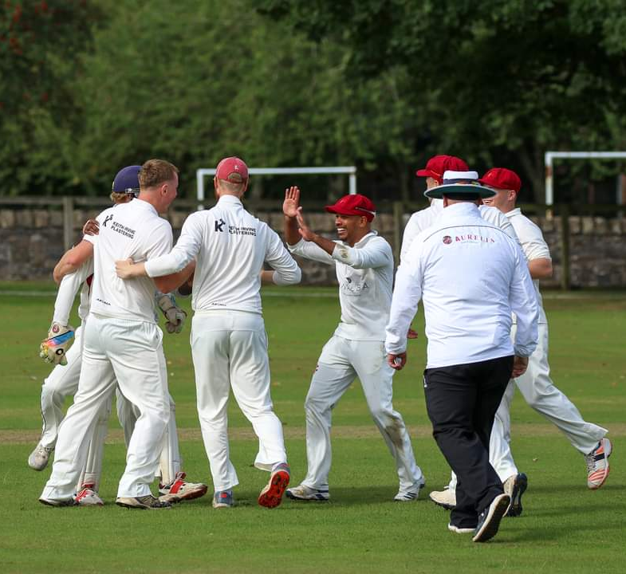
PLAYER SPONSORSHIP
For only £50 you can sponsor one of our players.
Why sponsor a player?
Exclusive promotional posts shared across all of our social media platforms announcing your player sponsorship to 4000+ followers.
Your logo displayed on our player profile feature which will be shared on social media throughout the season.
Your brand will be promoted when your sponsored player performs.
Invite for two people to supporters day with complimentary buffet and drinks.
Cost: £50 per season
Page 5

Slide 7
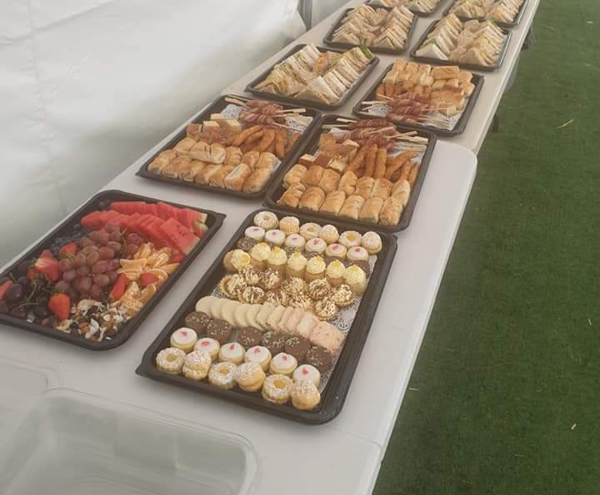
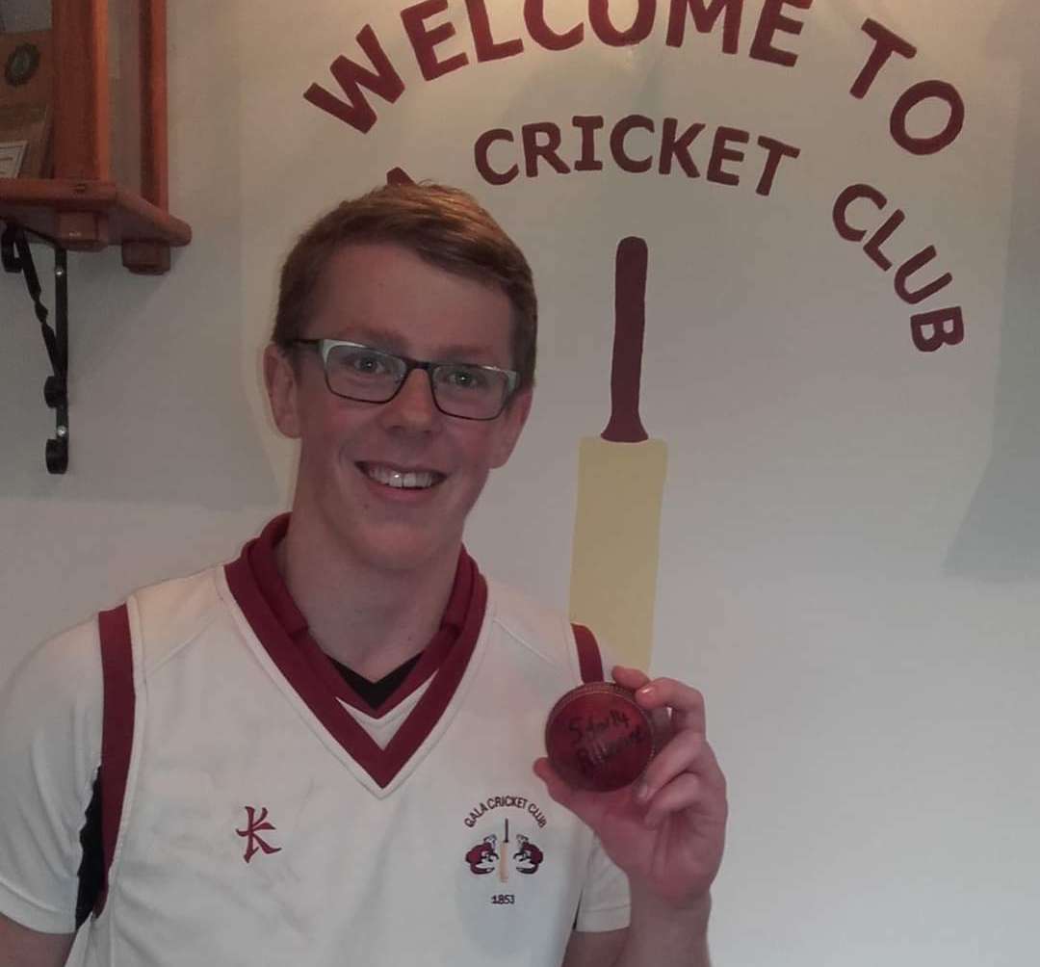
MATCH SPONSORSHIP
1st XI Match Ball Sponsor:
Company name/logo on front of match programme and all publicity about match (website and social media).
Cost: £30 per match
2nd XI /Sunday XI Match Ball Sponsor
Company name on all publicity about match (mention in Border Telegraph column, website and social media).
Cost: £20 per match
Match Teas Sponsorship
Company name on all publicity about match (mention in Border Telegraph column, website and social media).
Cost: £50 per match
Page 6

Slide 8
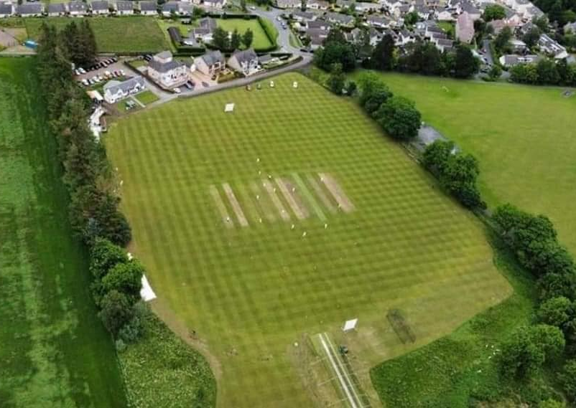
ADDITIONAL SPONSORSHIP
Umpire Sponsorship:
Company name/Logo appears in Programme and on umpire jackets for all games out with ESCA Championship.
Cost: £150 per season
Website Sponsorship:
Banner sponsor on Gala CC website: www.galacricketclub.co.uk
Cost: £150 per season
Page 7

Slide 9
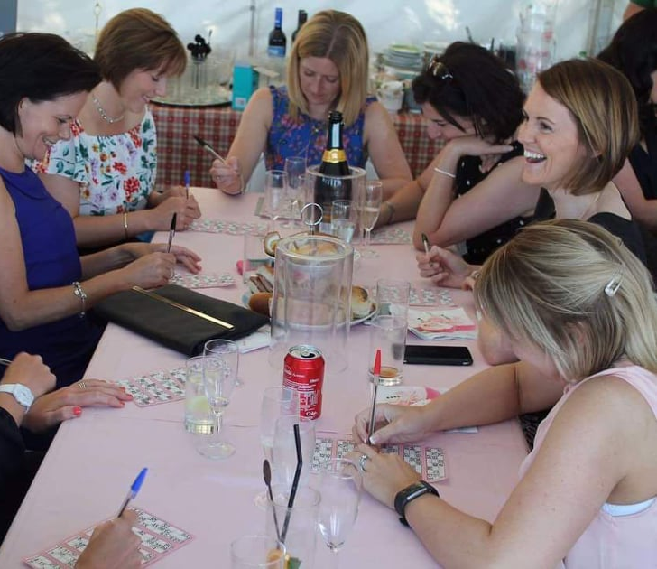
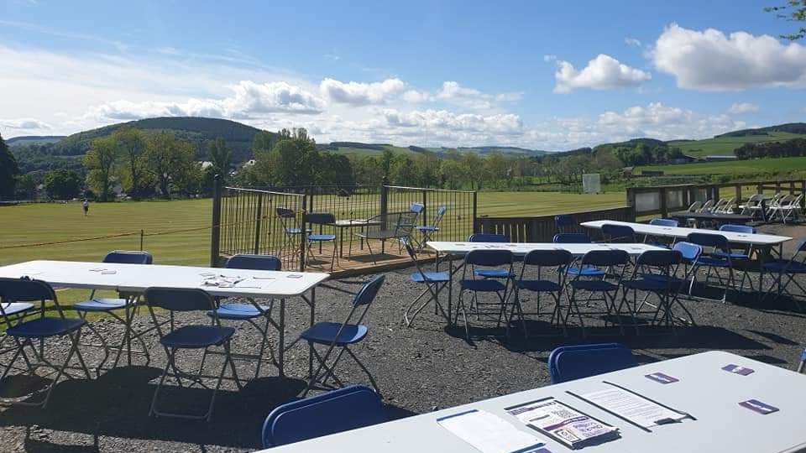
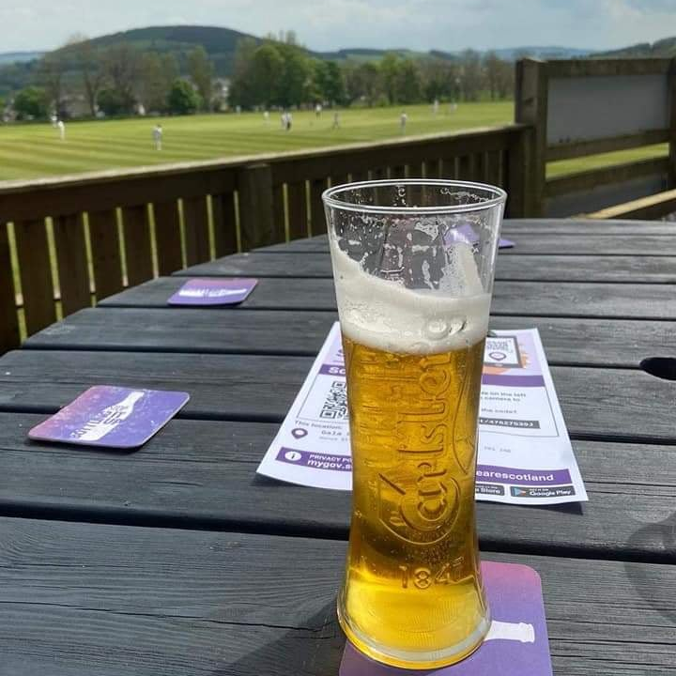
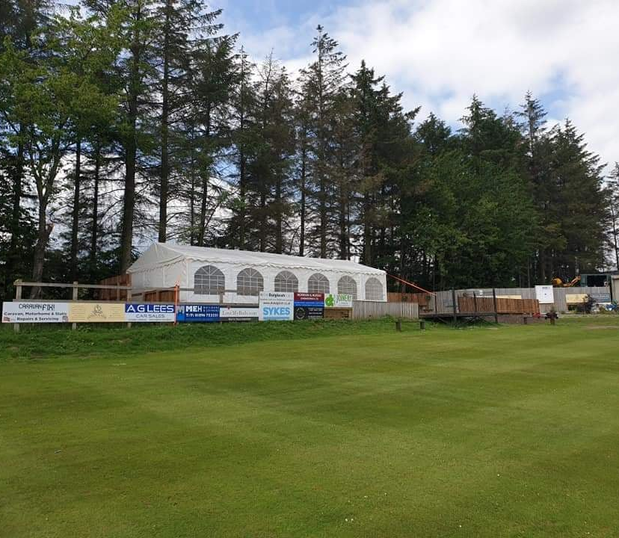
HOSPITALITY, EVENT AND VENUE HIRE
We offer hospitality packages for all home matchdays which include the use of our new beer garden and marquee area.
For more information or to enquire about options and pricing, please contact our social media or galacricketclub@gmail.com
Our clubhouse and marquee can also be used for other functions. If you would like to book any of our facilities for an event please contact us as above.
Page 8
Page 8

Slide 10
ABOUT OUR CLUB
CLUB STRATEGY
We have a new five year strategy based on four themes – inclusive, community, growth and legacy –which has a series of actions associated with each.
If you would like to get involve in driving forward the club, please get in touch – galacricketclub@gmail.com
INCLUSIVE
Aims to ensure diversity is at the heart of what the club does
Previous achievements
We re-introduced a 2nd XI Saturday team for the first time in over 20 years in 2021.
We provide cricket for all ages—provided coaching from the age of five upwards thanks to involvement in All Stars Cricket and junior coaching sessions which is seeing our youngsters play teams from across the East of Scotland.
COMMUNITY
Aim to ensure the club is link to the community of Galashiels and surrounding area
Previous achievements
Held our first foodbank campaign in 2022 collecting over 30 bags for Gala Foodbank
Host Rowan Boland Run & Rowan Boland Under 12s Cricket Tournament— both encourage children to be active and take part in sport
New bar area has created which is available for events throughout the year
Events area—creation of new area means regular hospitality events are held.
GROWTH
Centred on the club always striving to improve
Previous achievements
We have made considerable efforts to raise our profile in recent years with over 4,000 followers.
New website - www.galacricketclub.co.uk Media coverage—weekly column in Border Telegraph and weekly match reports and features on club during season in local press
Recent good work has seen club awarded regional club of year titles
LEGACY
Centred on leaving the club in a better position than before
Long term aim to create a new community pavilion
Previous achievements
Our firsts are playing in the East Championship this season, the second highest level in Scotland. The team won the league in 2022 for the second year in a row and narrowly missed out on promotion to the Premiership.
We have three recent female Scottish Internationalists including a member of the Scotland u19 World Cup squad.
Page 9

Slide 11
THANKYOU
FOR FURTHER INFORMATION ON SPONSORSHIP OPPORTUNITIES OR TO CONFIRM YOUR SUPPORT FOR GALA CRICKET CLUB PLEASE CONTACT OUR SOCIAL MEDIA PAGES OR
EMAIL: GALACRICKETCLUB@GMAIL.COM
PHONE: 07913767871
@gala_cricket
Gala Cricket Club
@galacricket_

